Slide 1
WELCOME
Soil Health and Sustainability for Field Staff
Enter Location and Date here

Slide 2

Keep an open mind
Listen to learn, not to rebut
Question to clarify, not to corner
Disagree without being disagreeable
Be respectful of others
No whining
Return from Breaks ON TIME
Turn your cell phone ringers off
Use the “Parking Lot”
Leave policies are in effect during training, if you are late or absent from class you will be charged leave

Slide 3
Introduction to Soil Health
Presenter Name
Date
Location

Slide 4
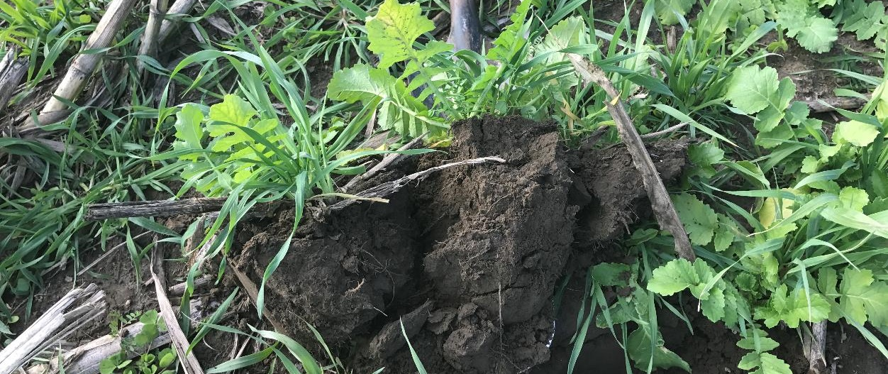
Objectives
Define soil health and discuss why different words in the definition are important
List the primary functions of soil and impact on the environment or ecosystem
Describe importance of soil health on all land uses & society
Cochrane, NRCS

Slide 5
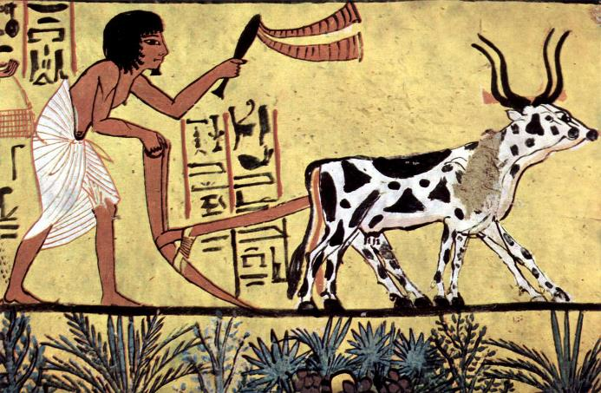
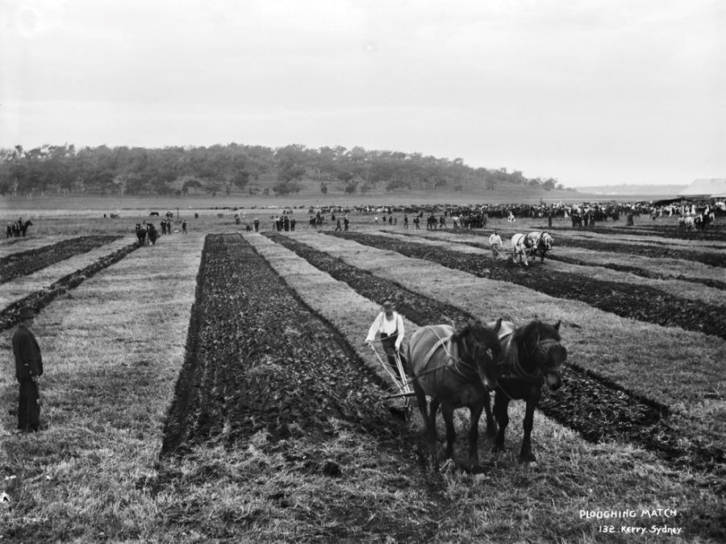
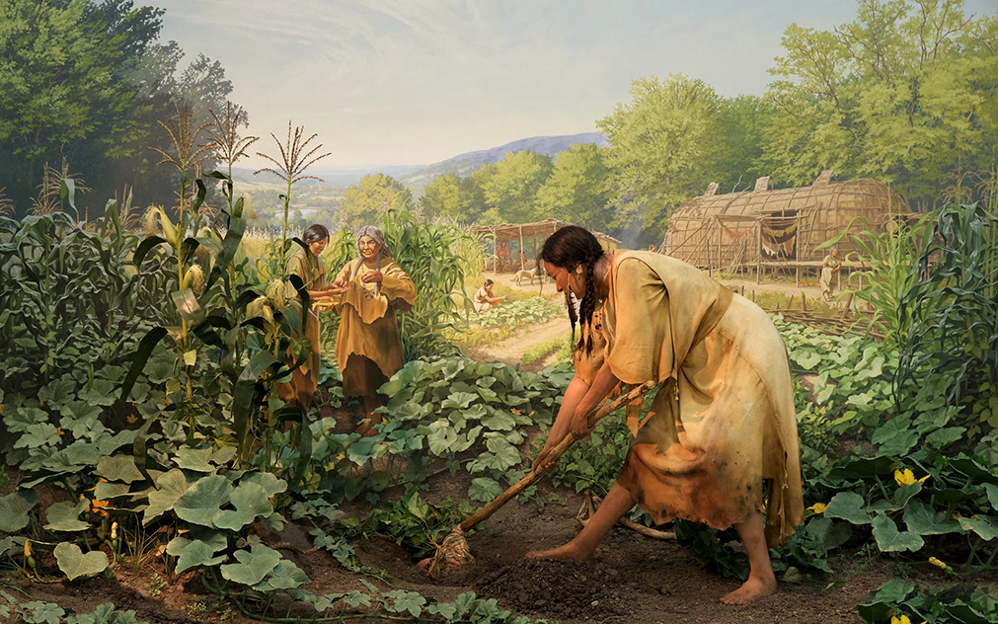
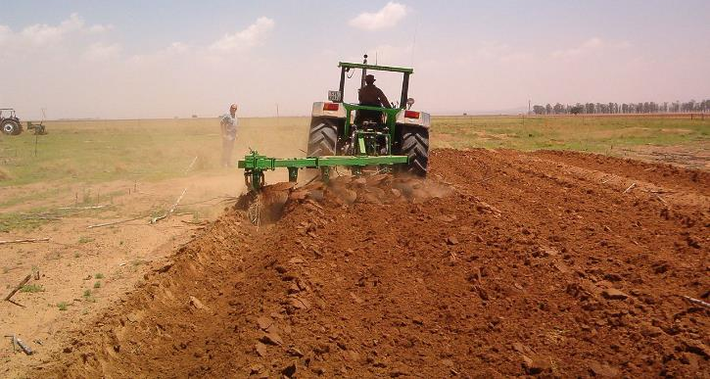
Our traditions in agriculture are deeply rooted.
Early management necessitated working with natural systems.
As mechanization advanced and scale and intensity grew our management principles became focused on altering natural systems to meet our needs.
Notes:
As long as our tools involved wood in our hands and our horsepower was supplied by… horses, or oxen, then we pretty much had to work with nature.
When the tools in our hands became steering wheels and push buttons and our power was supplied by hundreds of horses packed into a diesel engine, then our natural drive led us to management principles for controlling nature.
John Deere invented the steel plow in 1837 when the Middle-West was being settled. The soil was different than that of the East and wood plows kept breaking.

Slide 6
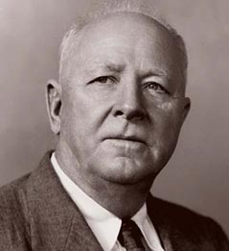
“If we are bold in our thinking, courageous in accepting new ideas, and willing to work with instead of against our land, we shall find in conservation farming an avenue to the greatest food production the world has ever known…”
-Hugh Hammond Bennett
September 18, 1943
Wikipedia
Notes:
Need to be open-minded to new ideas. Need to look at alternative methods of farming and think outside the box. Also need to consider working with nature instead of against it – conventional practices often work against the natural processes.

Slide 7
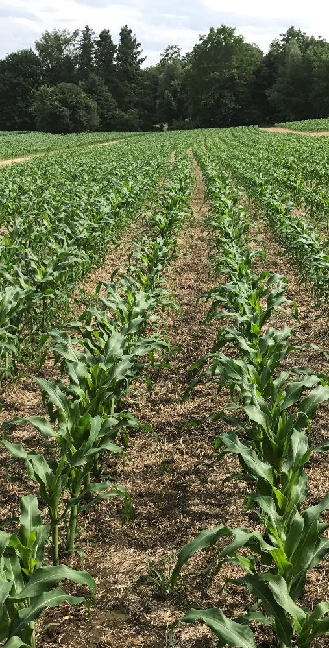
What Functions Would We Like our Soil to Provide?
Produce food, feed, fiber, biofuels & medicine
Capture, filter, and store water
Cycle and recycle nutrients
Resilience to drought, flood & temp extremes
Protect plants from pathogens and stress
Detoxify pollutants
Store carbon and moderate release of gases
Resist erosive forces
Cochrane, NRCS
Notes:
Ask the class to brainstorm desirable soil functions. These can be recorded on a board or flipchart—
Produce food and fiber
Capture and store water
Cycle nutrients
Resilient to environmental stressors
Disease inhibition

Slide 8
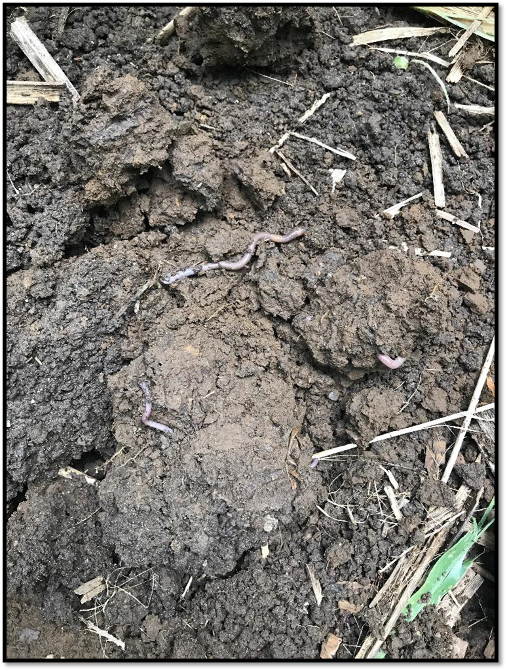
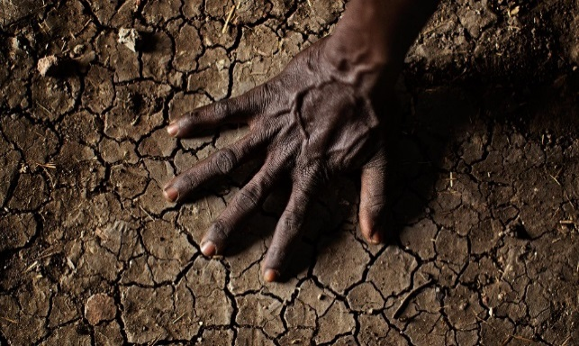
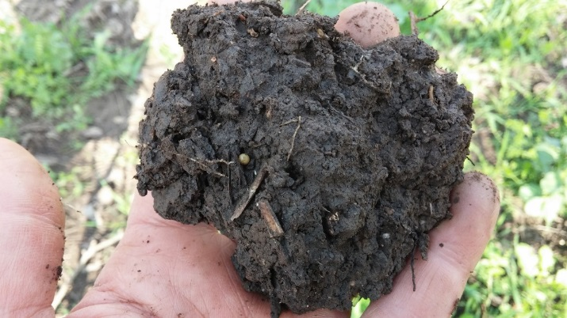
How does NRCS Define Soil Health?
The continued capacity of the soil to function as a vital living ecosystem that sustains plants, animal and humans.
Randy Mayers
Notes:
This definition focuses on the importance of soil function and soil as a living resource. When we speak of soil health, we are talking about improving the capacity of soil to function as a vital, living ecosystem that sustains plants, animals, and humans.
“Health” is usually used in the context of a living organism so managing soils for optimum health, in a way, ensures they are sustainable/alive for future generations.
This is the definition of Soil health we are using. The term “Health” was purposely chosen instead of “quality”.
Quality implies analysis and quantifying
Health implies management actions that leads to a condition or state, there is something that can be done to change it to a positive trend
The key to the definition is that soil health is:
Continued capacity—implies rejuvenation and then sustainability
Soil is a living ecosystem– recognize the ground beneath as a living ecosystem (Land use and ecosystem boundaries)
Soil function – soils need to provide the basic functions for food & fiber production.
How well is your soil functioning to feed and water your plants?
this definition focuses our efforts on the importance of managing soils within ecosystem and land use boundaries we are presented with, in a way that ensures they are sustainable for future generations. (Focus is on Management

Slide 9
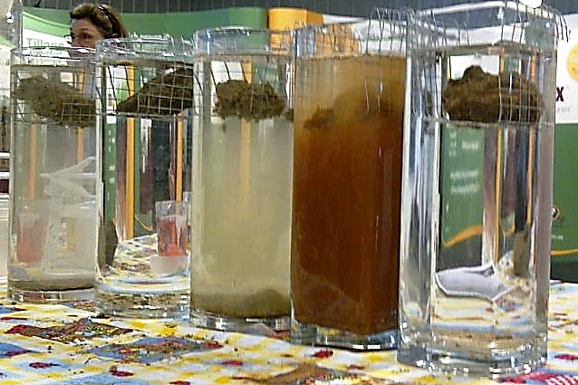

Demonstrate How Management Affects Soil Function
Notes:
Slake, desktop rainfall sim. Slump/strainer test, use Nitrate strips in runoff from desktop rainfall discuss. Silly string aggregates.

Slide 10
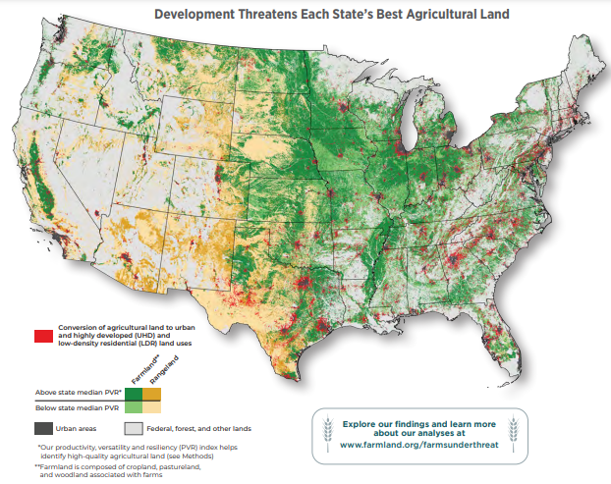
Producing More on Fewer Acres – Development Pressure
Between 2001 and 2016, nearly 11 million acres lost
2000 ac per day covered over in pavement
40% of all development was on prime farmland the size of New Jersey
Farms Under Threat: The State of the States, AFT
Notes:
Loss of soil function directly affects productivity. Loss of productive capacity, especially in light of extreme weather, is compounded by the loss of farm and ranch acres.
Compounding these impacts, 4.4 million acres of Nationally Significant land were converted to Urban Highly Developed UHD and Low density residential LDR land uses—an area nearly the size of New Jersey. AFT developed the Nationally Significant farmland designation to identify the most productive, versatile, and resilient (PVR) or prime farmland to NRCS, land for sustainable food and crop production. The United States is home to 10 percent of the planet’s arable soils—the most of any country on Earth. Yet even here, in what appears to be a vast agricultural landscape, only 18 percent of the continental U.S. is Nationally Significant land. As we face growing demand for high-quality food and environmental protection along with increasingly complex challenges from epidemics, extreme weather, and market disruptions, it is especially important to protect the land best suited to intensive food and crop production, including fruits, nuts, vegetables, and staple grains
Technology will contribute to improving productivity on acres, but improving the ability of soils to remain productive is critical to maintaining food (and national??) security.
Freegood, J, M. Hunter, J. Dempsey, A. Sorenson. 2020. Farms under threat: the state of the states. Available at: https://farmlandinfo.org/publications/farms-under-threat-the-state-of-the-states/ Verified on 2022.05.03. Northampton, MA pp.68.

Slide 11
Soil Health and Function
Soil with high resistance
Disturbance
100
Soil with low resistance and high resilience
Soil function (% of capacity)
Soil with low resistance and low resilience
Time
Adapted from Brady & Weil, 2008
Notes:
BEFORE YOU ADD THE LINES TO THE FIGURE, SAY:
Soils, like ecosystems will respond to disturbance in particular, sometimes predictable ways.
We can talk about a soil’s resistance and resilience.
Resistance related to a soil is its ability to remain relatively unchanged when exposed to disturbance. Soils with high resistance are tolerant of disturbance.
Resilience is the ability and rate of a soil to return to its pre-disturbance state.
Examples of disturbance would be extreme weather events. Anything that stresses the system.
We can plot relative soil function over time. 100% is the functional capacity for a particular characteristic, for a particular soil, in a particular place. Soils will differ in functional capacity. Management often modifies the capacity of a soil.
CLICK – a given soil will function at its capacity. CLICK – at time “X” a disturbance affects the soil. Again, this could be drought, intense rainfall, physical disturbance, chemical disturbance,…
CLICK AND DISCUSS HIGH RESISTANCE – resistant soils tolerate disturbance and maintain a relatively high functional capacity.
CLICK AND DISCUSS LOW RESISTANCE AND HIGH RESILIENCE
CLICK AND DISCUSS LOW RESISTANCE AND LOW RESILIENCE
**IN ORDER FOR SOILS TO “CONTINUE TO FUNCTION AS A VITAL LIVING ECOSYSTEM…” THEY WILL REQUIRE MANAGEMENT USING THE PRINCIPLES THAT LEADS TO GREATER RESISTANCE AND RESILIENCE, OR REQUIRE GREATER AND GREATER AMOUNTS OF INPUTS.
Developed by Dennis Chessman, USDA NRCS (Emeritus)

Slide 12
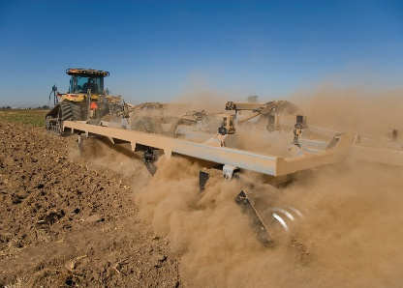
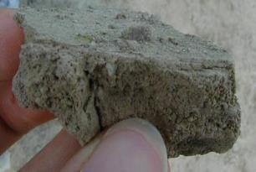
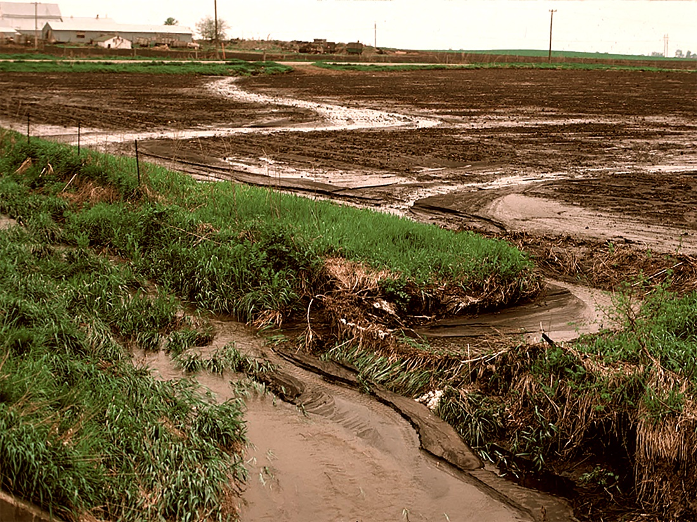
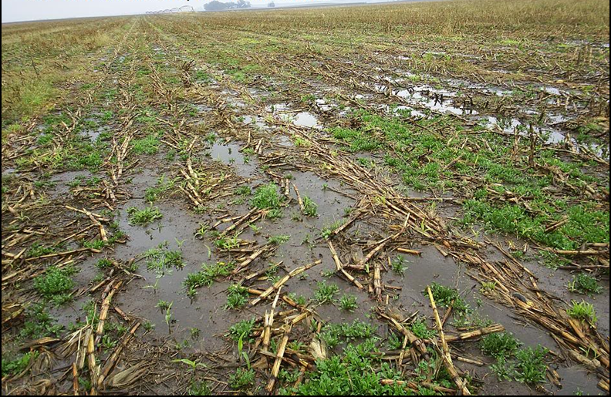
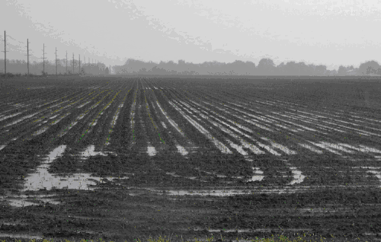
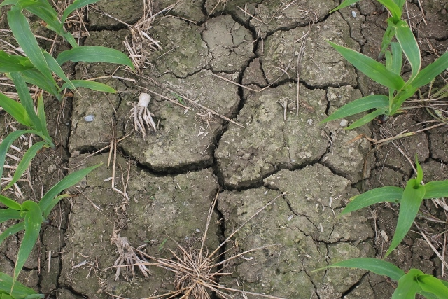
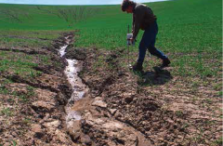
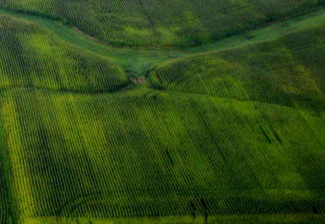
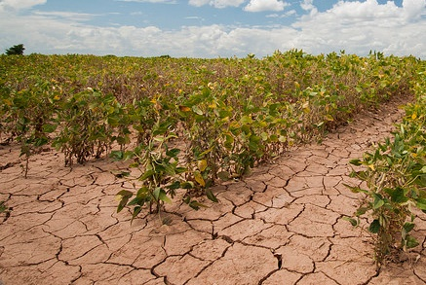
Downward Spiral of Soil Degradation
↑ Tillage
↓ Residue
↓ Diversity
Aggregate
Stability ↓
SOM ↓
Erosion ↑ Compaction ↑
↓ Infiltration
↑ Erosion
Ponding ↑
H₂O Storage ↓
↑ Crusting
↑ Surface Compaction
SOM ↓ ↓
Nutrients ↔
Topsoil ↔
↓ Nutrient
Availability
↑ Disease
↓Crop Yields
↑Hunger
↑Malnutrition
Adapted from Building Soils for Better Crops, 3rd ed.
Notes:
Up arrows are increasing- down arrows are decreasing and arrows that are horizontal indicates offsite movement or displacement
There are soil and broader societal consequences resulting from the way that annual crops are typically managed.
When management includes routine, full-width tillage resulting in plant residue being buried, and minimal crop diversity (corn-beans), the resulting changes in soil can be described as a downward spiral.
Lead the class through the progression that inevitably results.
This is the typical condition of annual cropland in the US. Soils in this condition would be characterized low resistance and usually, low resilience.
Agricultural systems that seek to improve soil function can reverse these trends.

Slide 13
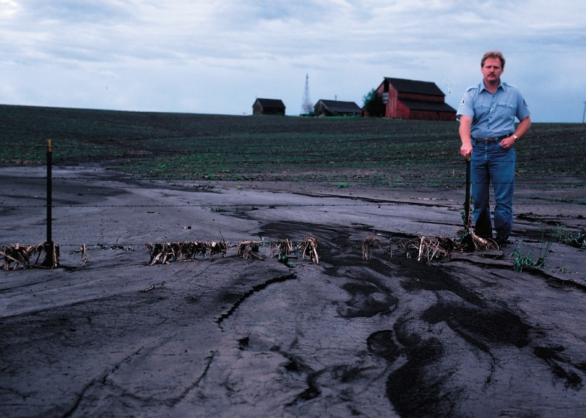
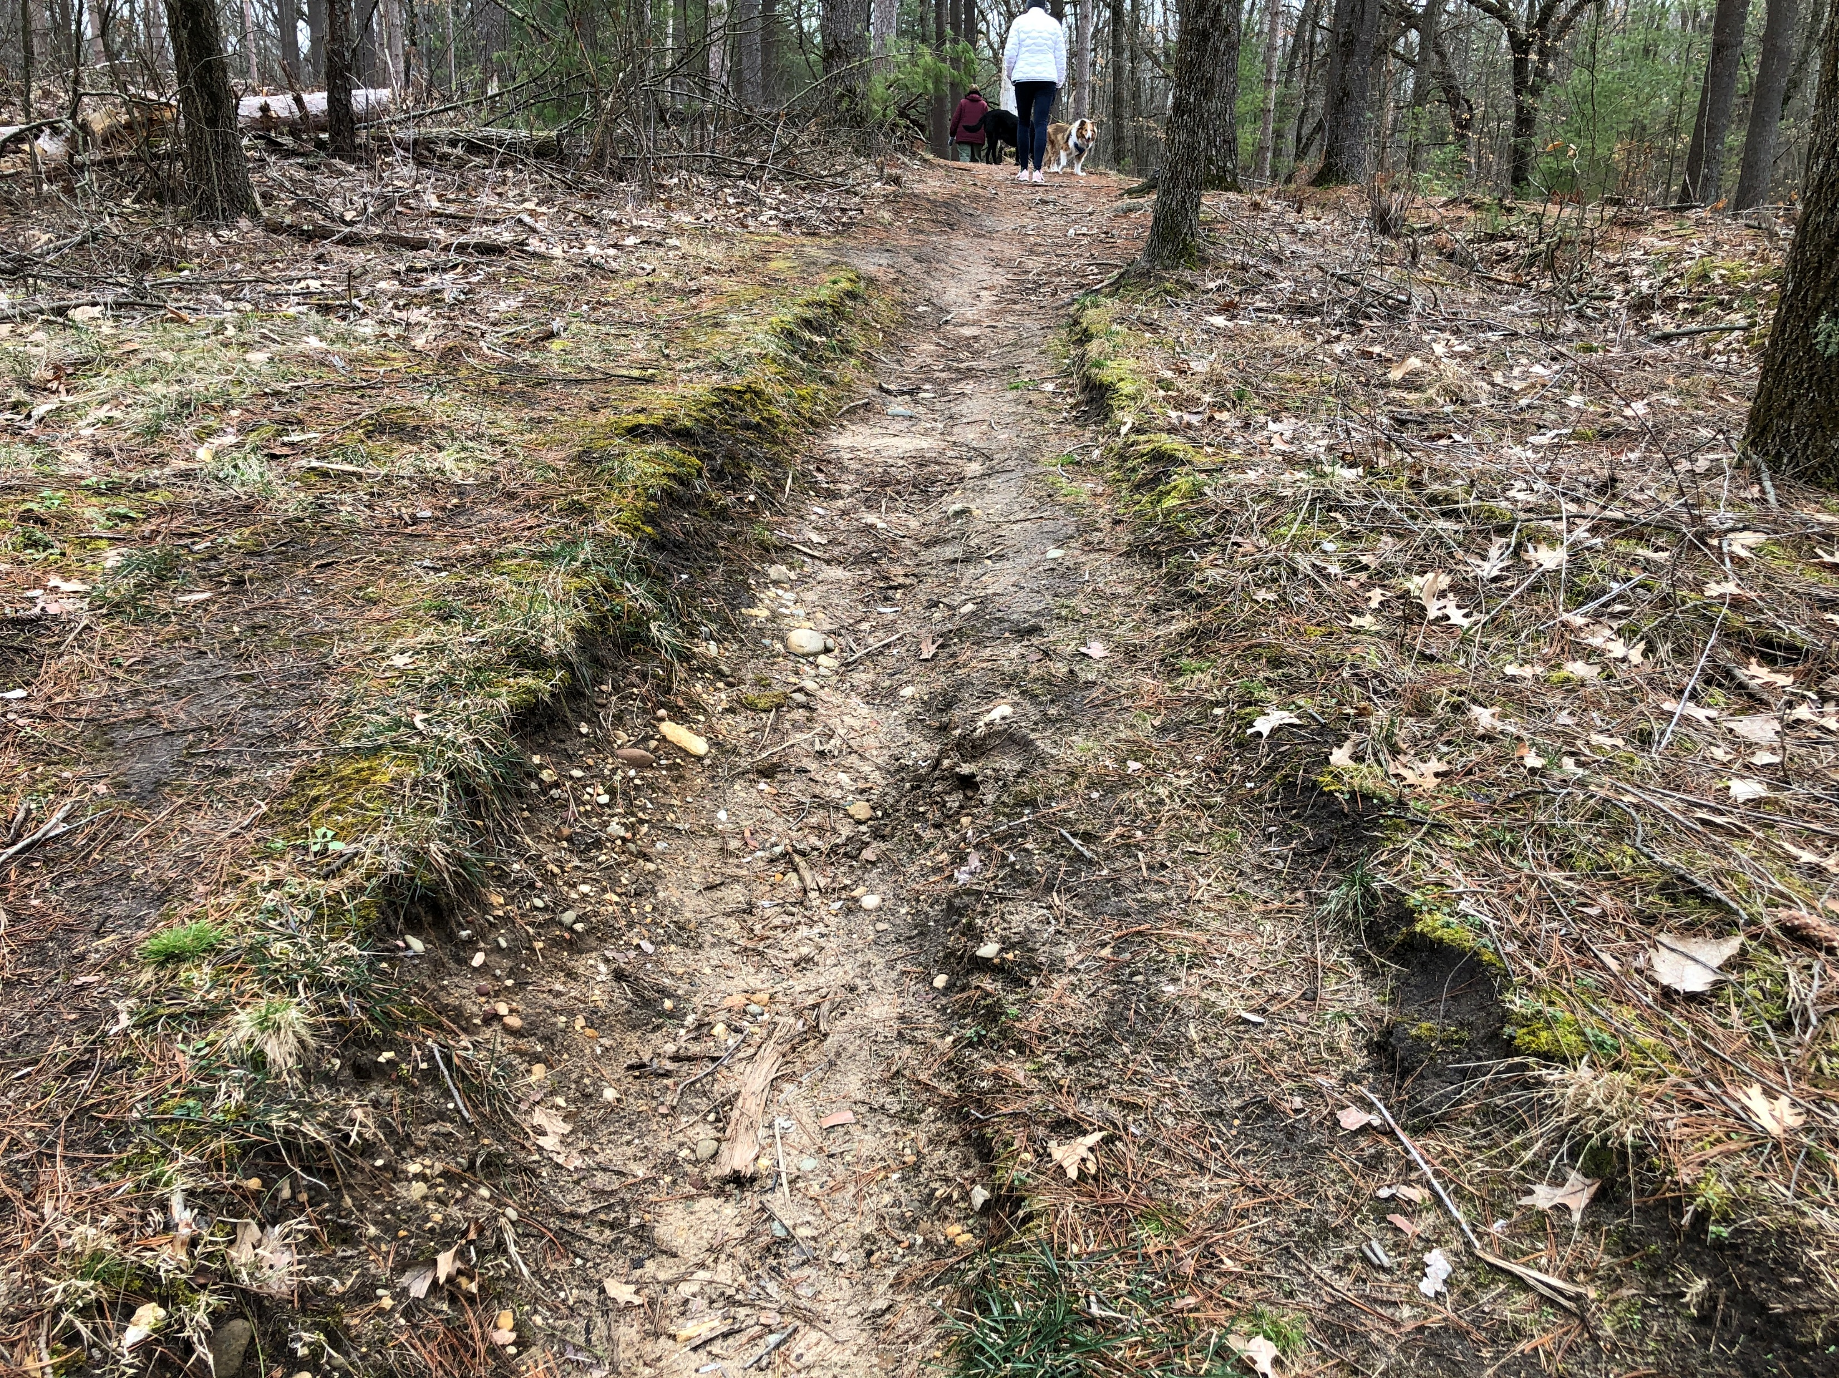
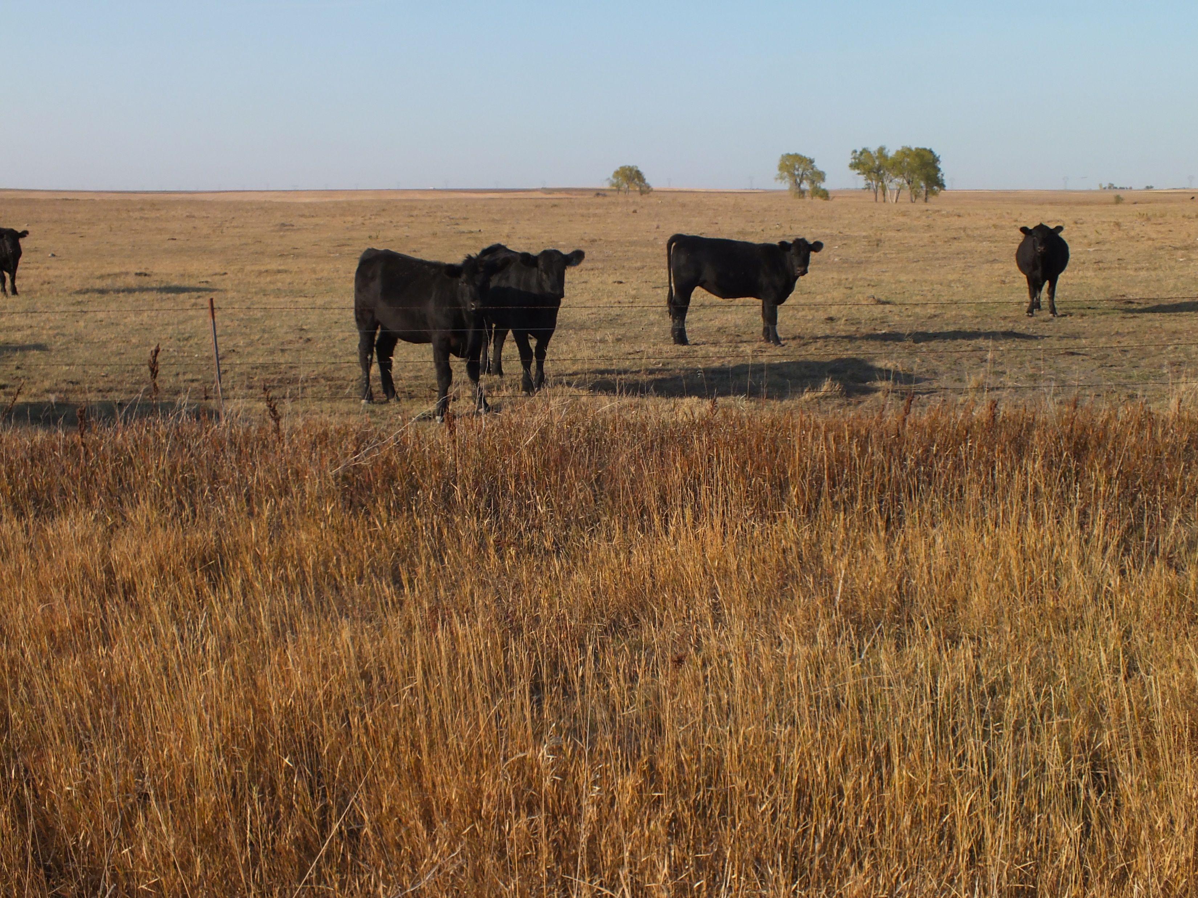
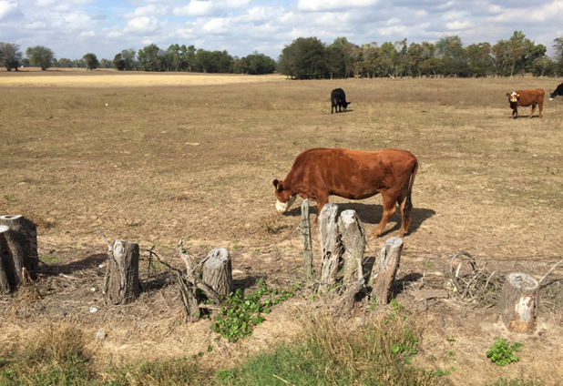
Characteristics of Soil Function Loss
Lynn Betts, USDA-NRCS
Tom Sauer, USDA
Stan Boltz , USDA
Drexel Atkisson, USDA
Notes:
Degraded soils that have decreased function have telltale characteristics.
There is general agreement that weather events related to precipitation and temperature are becoming more extreme– more frequent and extensive drought, more intense rainfall events, higher temperatures.
Proper soil function should contribute to mediating some of these extreme events.
Inadequate water infiltrations can lead to water erosion
Poor soil water storage capacity can result in greater incidence of crop drought stress
Aggregate instability makes some soils mud pits when it rains
Although nutrient and pesticide applications are important for maintaining crop production, excessive dependence on inputs are often an indication that soils are not significantly contributing to crop growth needs.
Rangeland picture is a blue grama/clubmoss plant community on a Loamy ecological site in MLRA 54

Slide 14
Soil Improvement Climb
Improved Water
Availability
Visibility
Improved Soil
Structure
Noticeable Change
Improved Nutrient
Cycling
Organic Matter
Turnover
Biological
Activity
Adapted from Hatfield et.al.
Notes:
Optional Slide
Process of soil improvement of stable aggregates with enhanced biological activity
Depicts how soil changes when soil biology is enhanced with the stabilization of the soil biology being the first step in changing the soil organic matter content. Changes in soil organic matter manifest in the invisible processes of organic matter decay and nutrient cycling and finally in the visible processes of improved aggregate or soil structure and water availability.

Slide 15
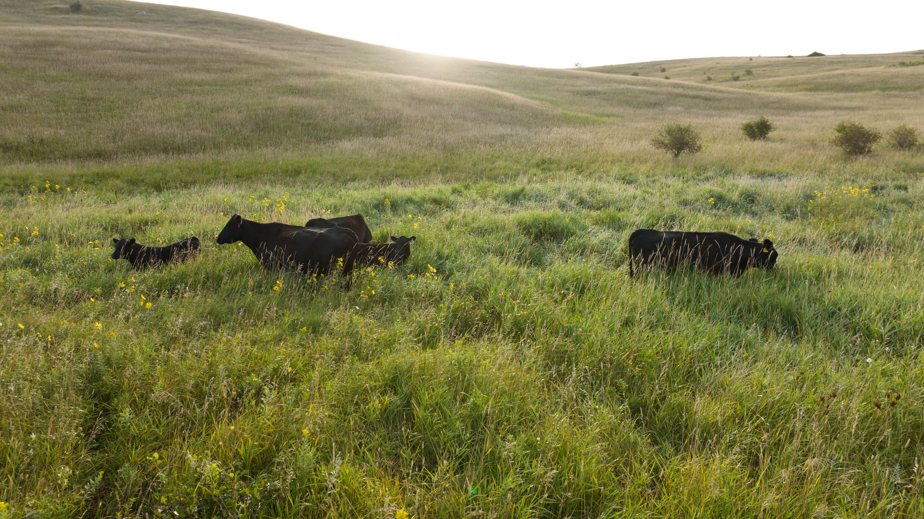
Rangeland
Rangeland
Low inputs
Low to moderate stock densities
Three goals:
  Proper stocking
  Adequate recovery
  Change season of use
Maximizing diversity is most effective principle
Notes:
Inputs on rangeland are typically low (e.g., minimal pesticides, no fertilizer, reseeding, irrigation, etc.) - inputs on pasture are often greater (e.g., fertilization, irrigation, reseeding stands, controlling weeds regularly). But it might be worth pointing out that a pasture system can eventually become "self-sustaining" more or less like rangeland and not require so much in the way of inputs.
Rangeland ecosystems generally cannot support higher intensity stocking levels for extended periods, while pasture systems, often dominated by more grazing tolerant "tame" species, can handle higher stocking intensities.
Of the three goals, changing season of use is probably the most important for improving soil health on rangeland, while on pasture it is more a combination of proper stocking and adequate recovery.

Slide 16
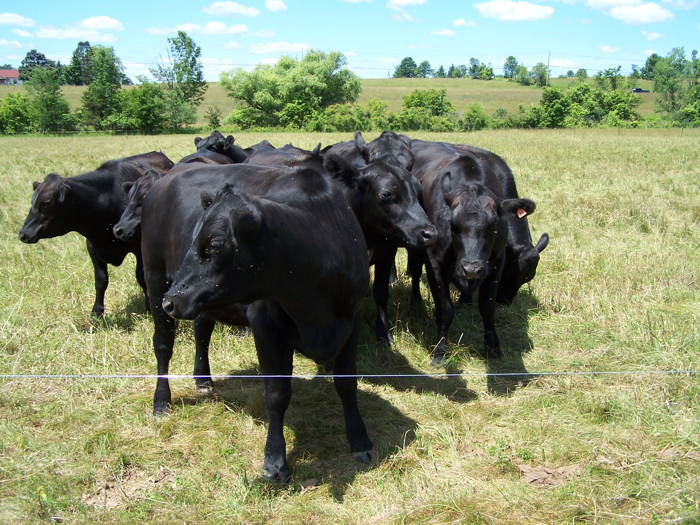
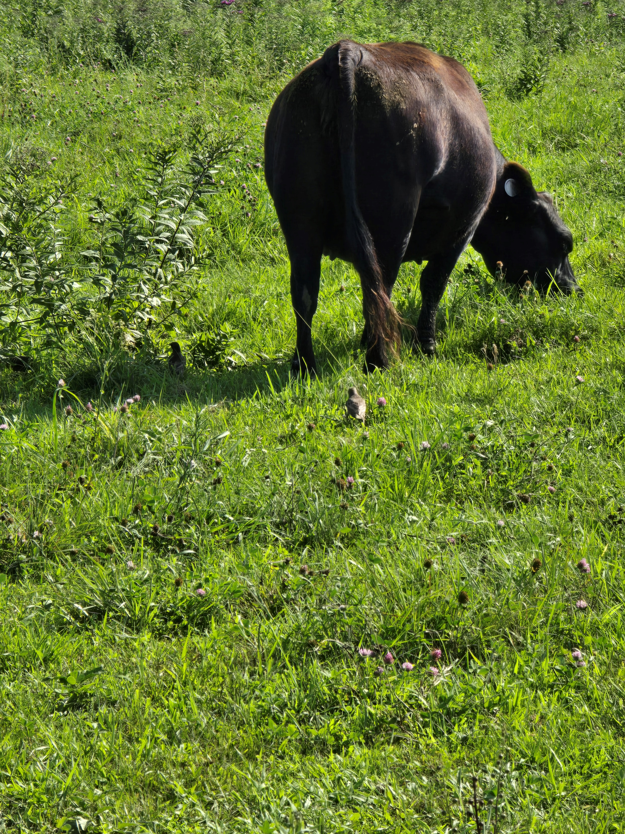
Pasture
Pasture
Often higher inputs
Moderate to high stock densities
Three goals:
  Proper stocking
  Adequate recovery
  Change season of use
Optimizing disturbance is most effective principle
Photo RJ Dake
Notes:
In pastures optimizing the disturbance is most often a grazing event but can include other management practices such as fertilizing or liming. For grazing events in order to optimize the disturbance some level of adaptive management is needed. Observations need to be made and the grazing needs to be directed to the next paddock or area that has recovered the most. Varying the grazing event by season, intensity and duration will all provide different outcomes.

Slide 17
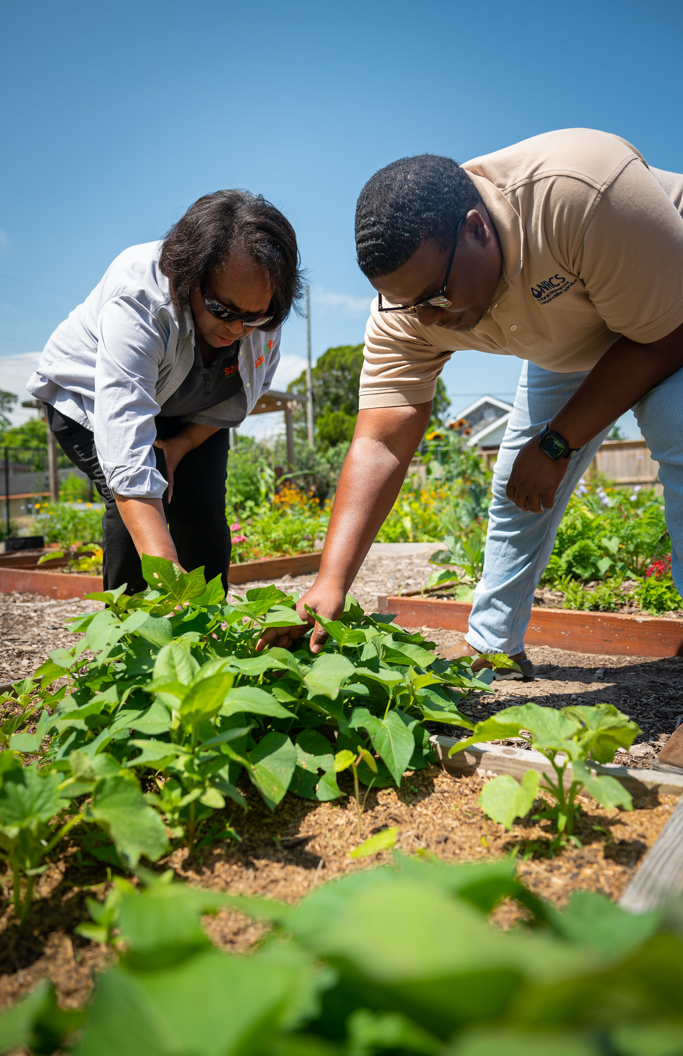
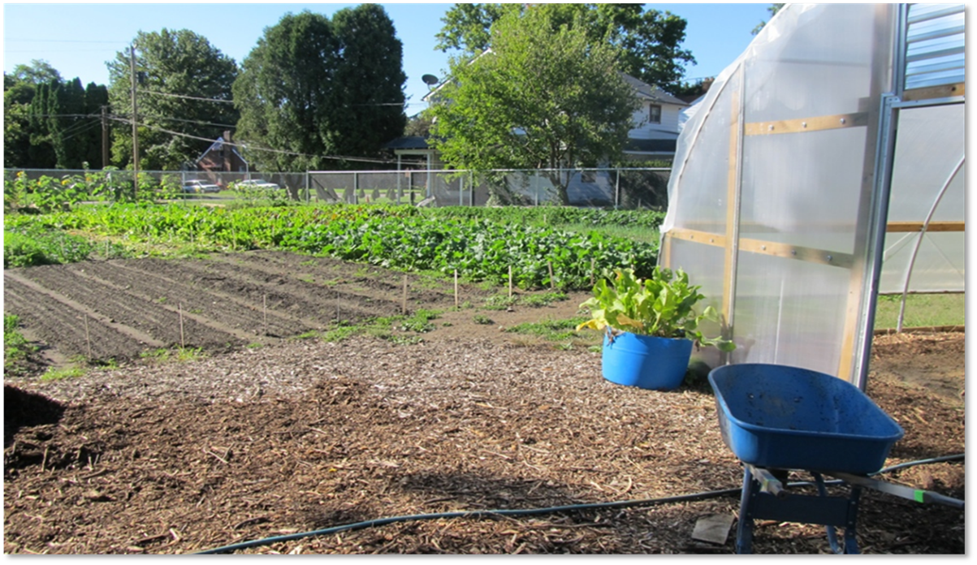
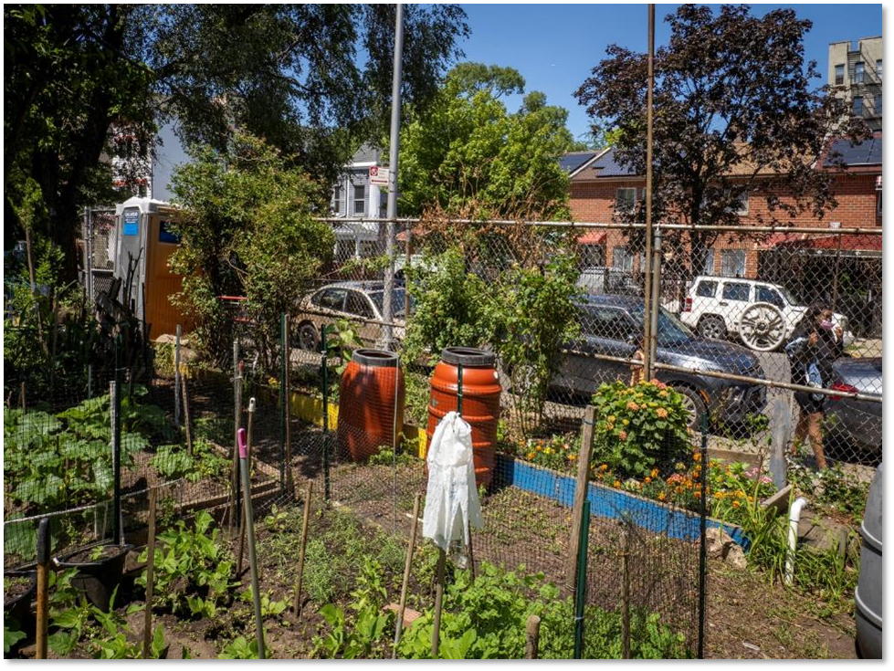
Urban Agriculture
Small-scale, intensively managed systems
SH conservation practices can work well at small scales.
Urban soils are highly variable. SH can be good or very poor.
Soil contamination by heavy metals and organic compounds is a common concern.
Notes:
Soil health management practices are likely to look different and will require different tools at small-scales, but they are very effective at improving soils in small-scale intensive systems.
Another point that could be mentioned is that urban agriculture soils are often highly amended. Many sites utilize constructed raised beds that are filled with soilless media such as potting soil or compost, rather than mineral soil
Photos: top photo by Josh Beniston, NRCS and bottom photo by USDA.

Slide 18

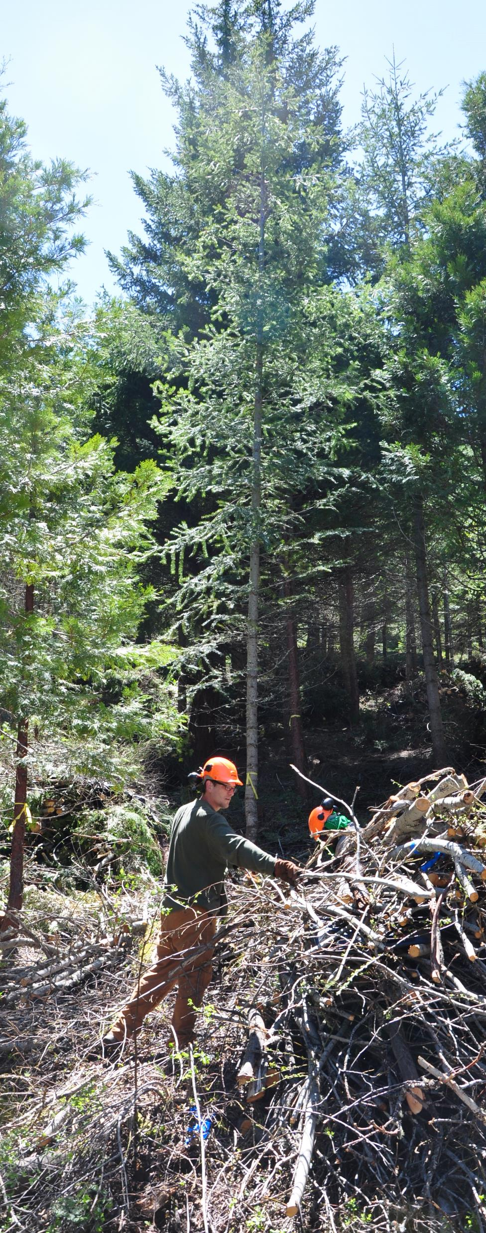
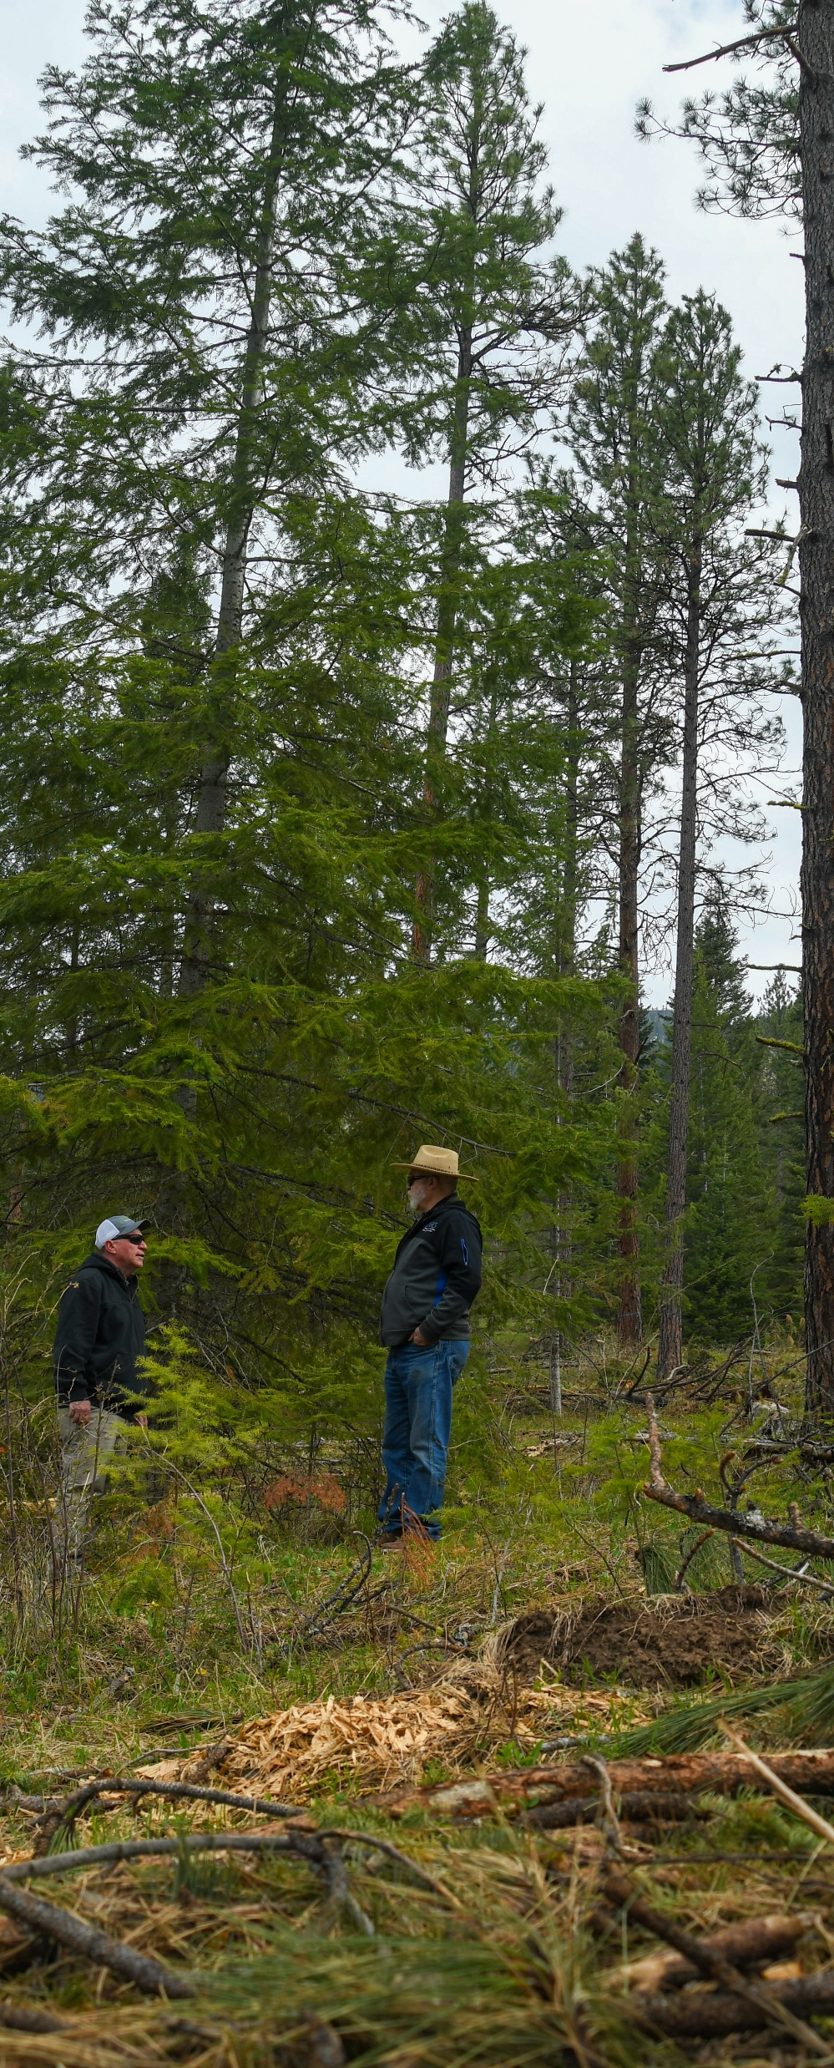
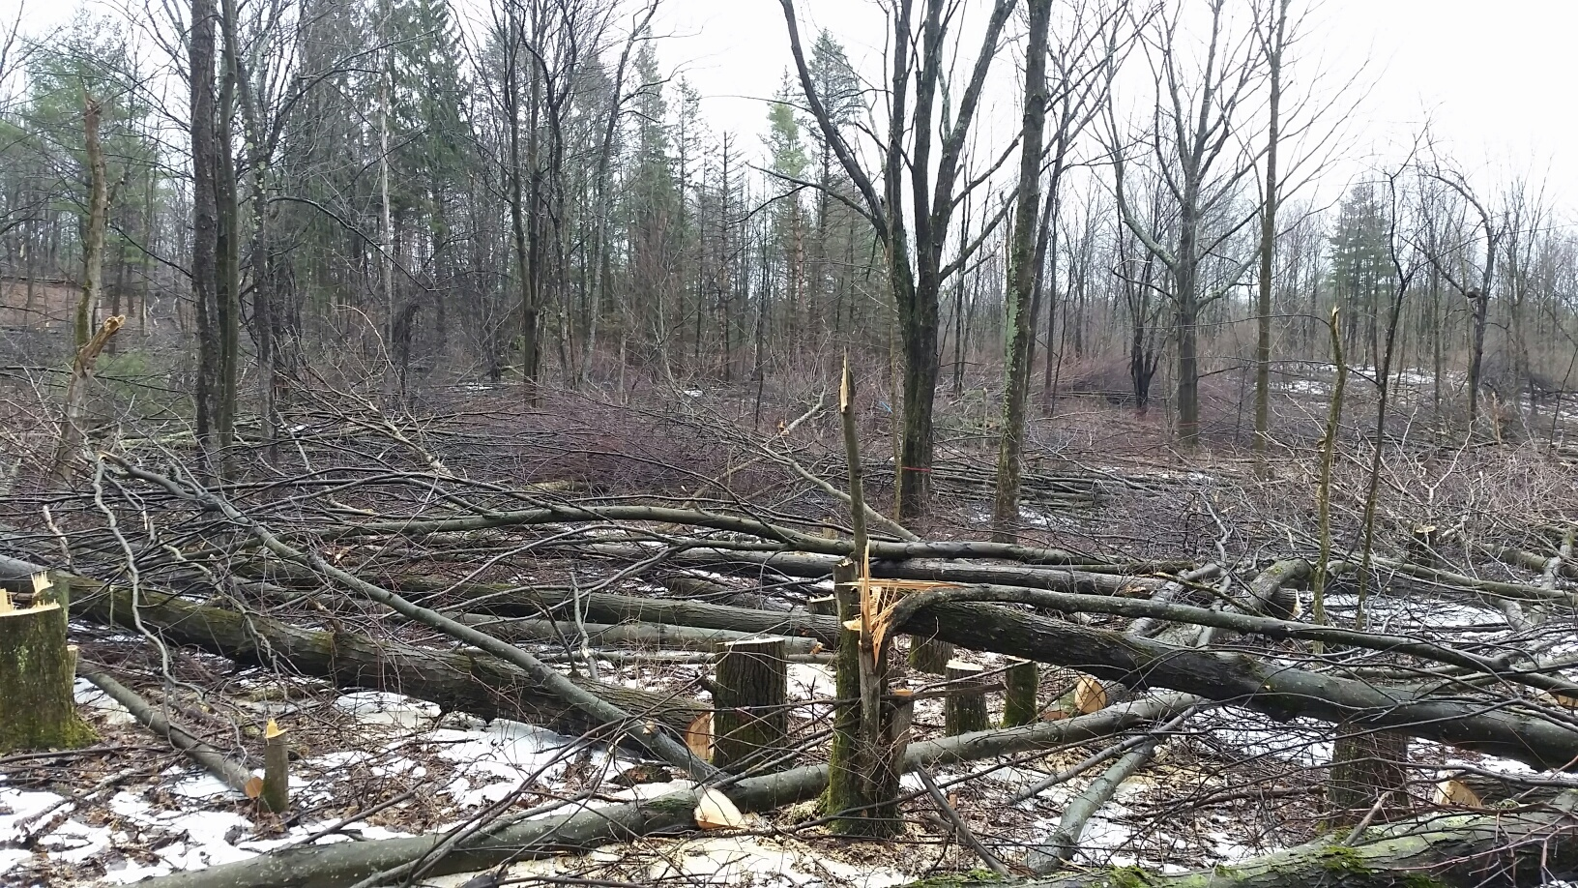
Forest
Low inputs
Usually, un-grazed depends on the state
Minimize disturbance and maximize biodiversity are the most effective principles
Photos: NRCS OR
Notes:
Photos from OR NRCS
Leaving coarse woody debris on ground (in areas where wildfires aren’t a concern) is crucial. Disturbance in this case would be disturbing the soil with machinery and by erosion/compaction. Disturbance in the form of cutting could actually increase carbon stocks.

Slide 19
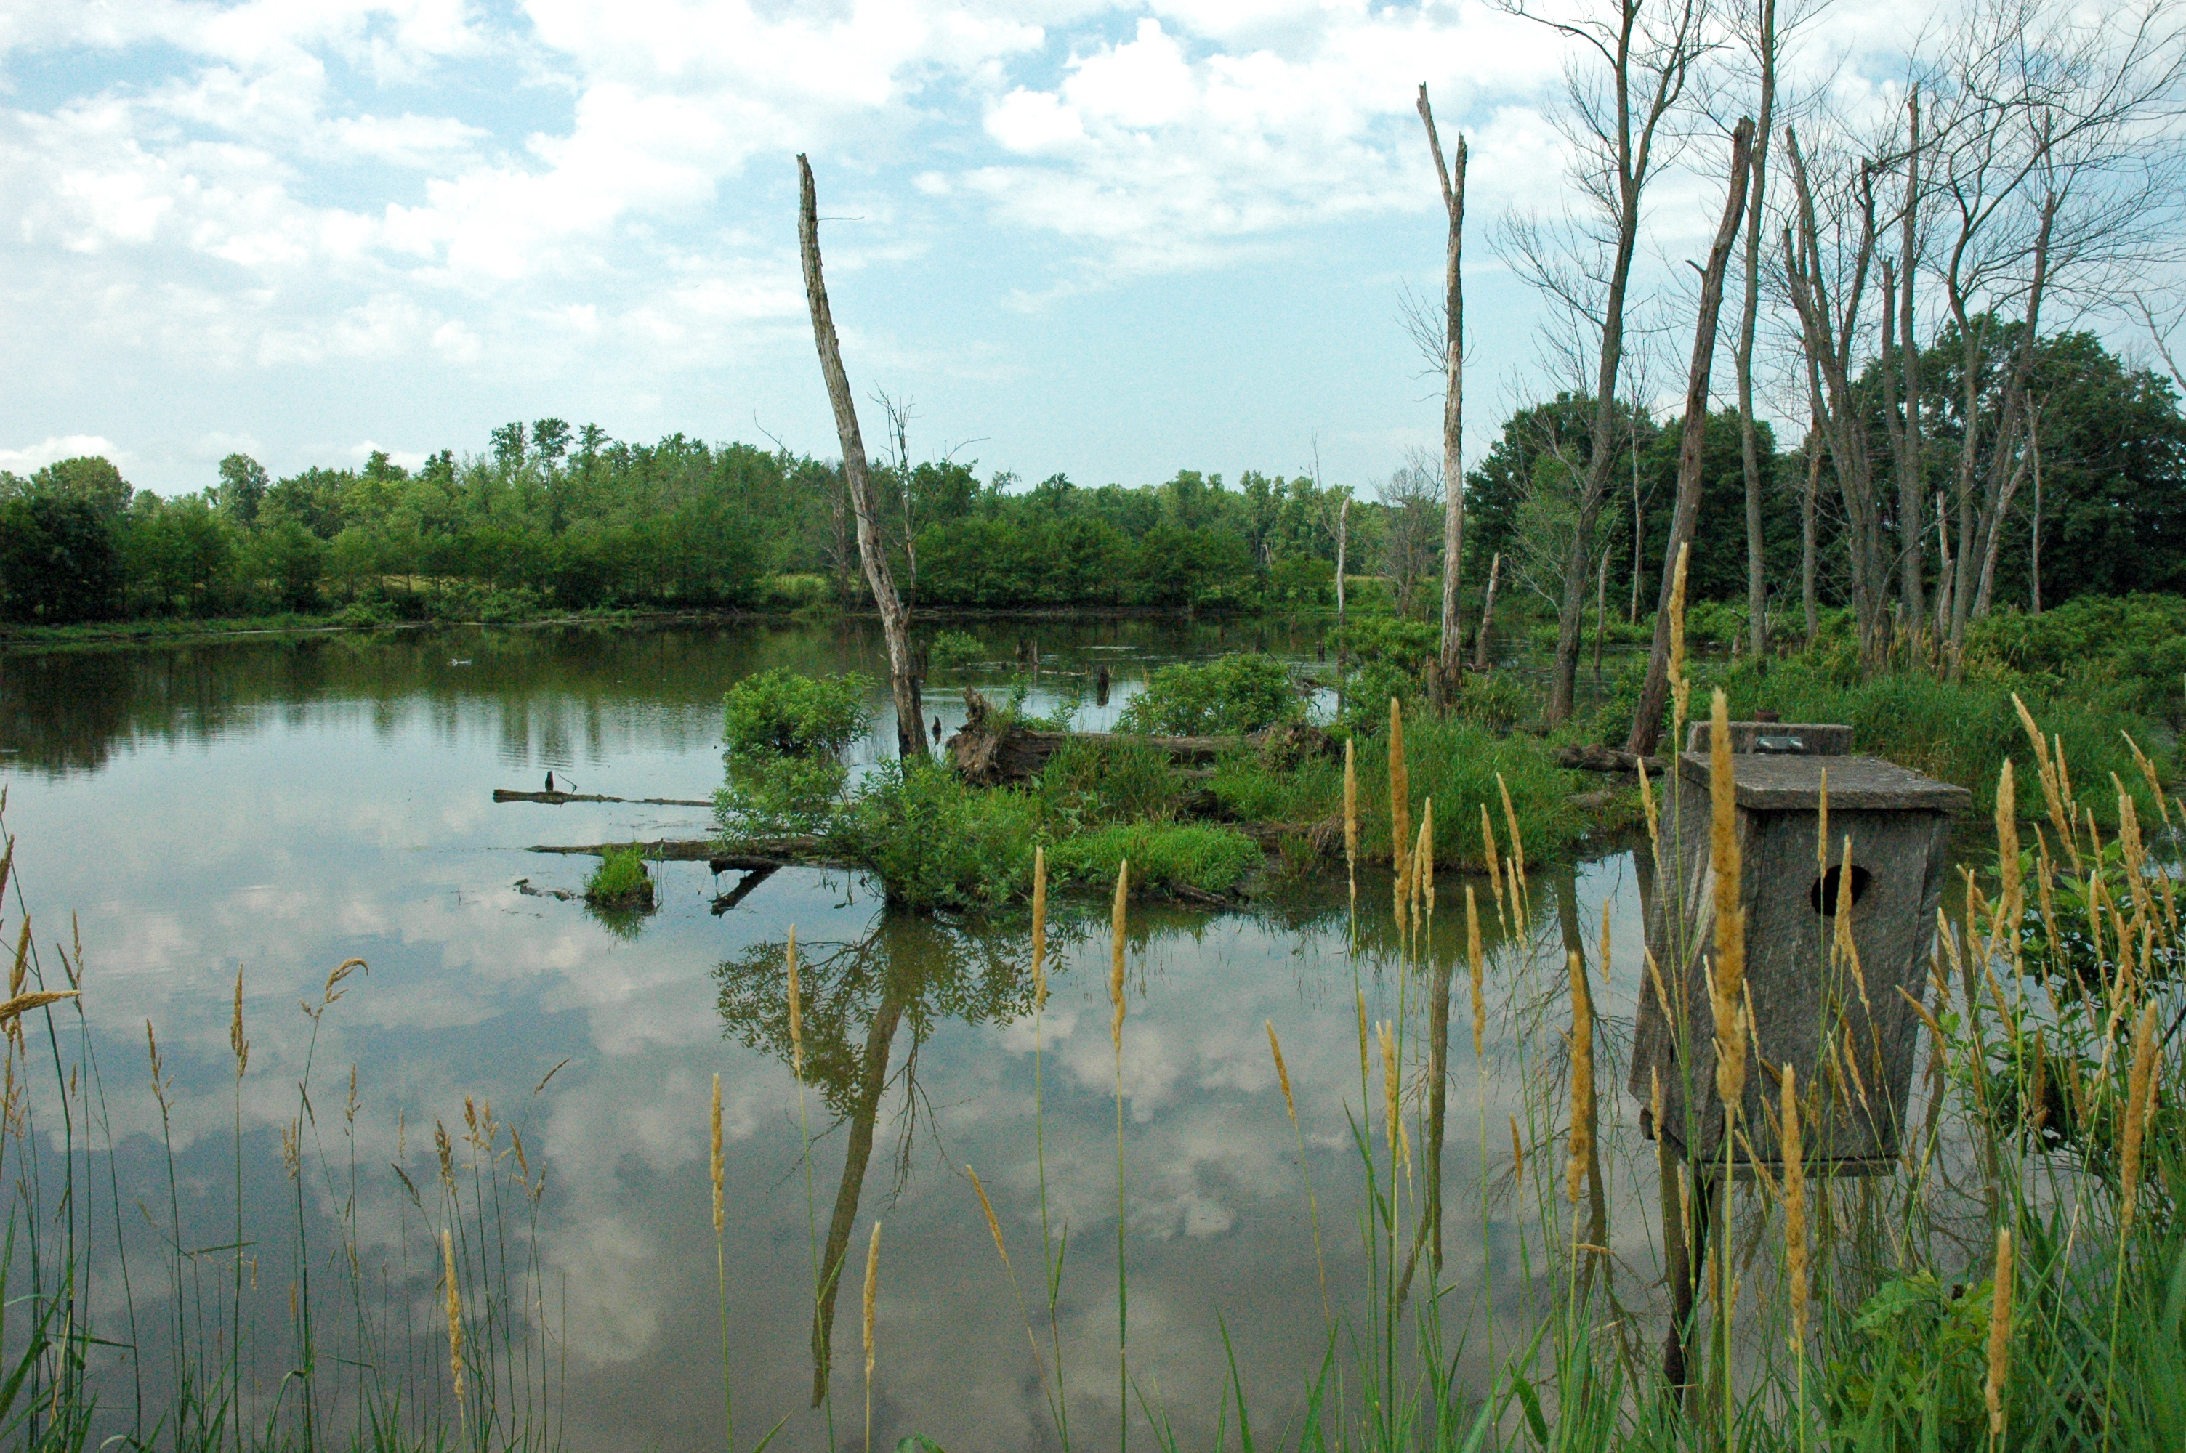
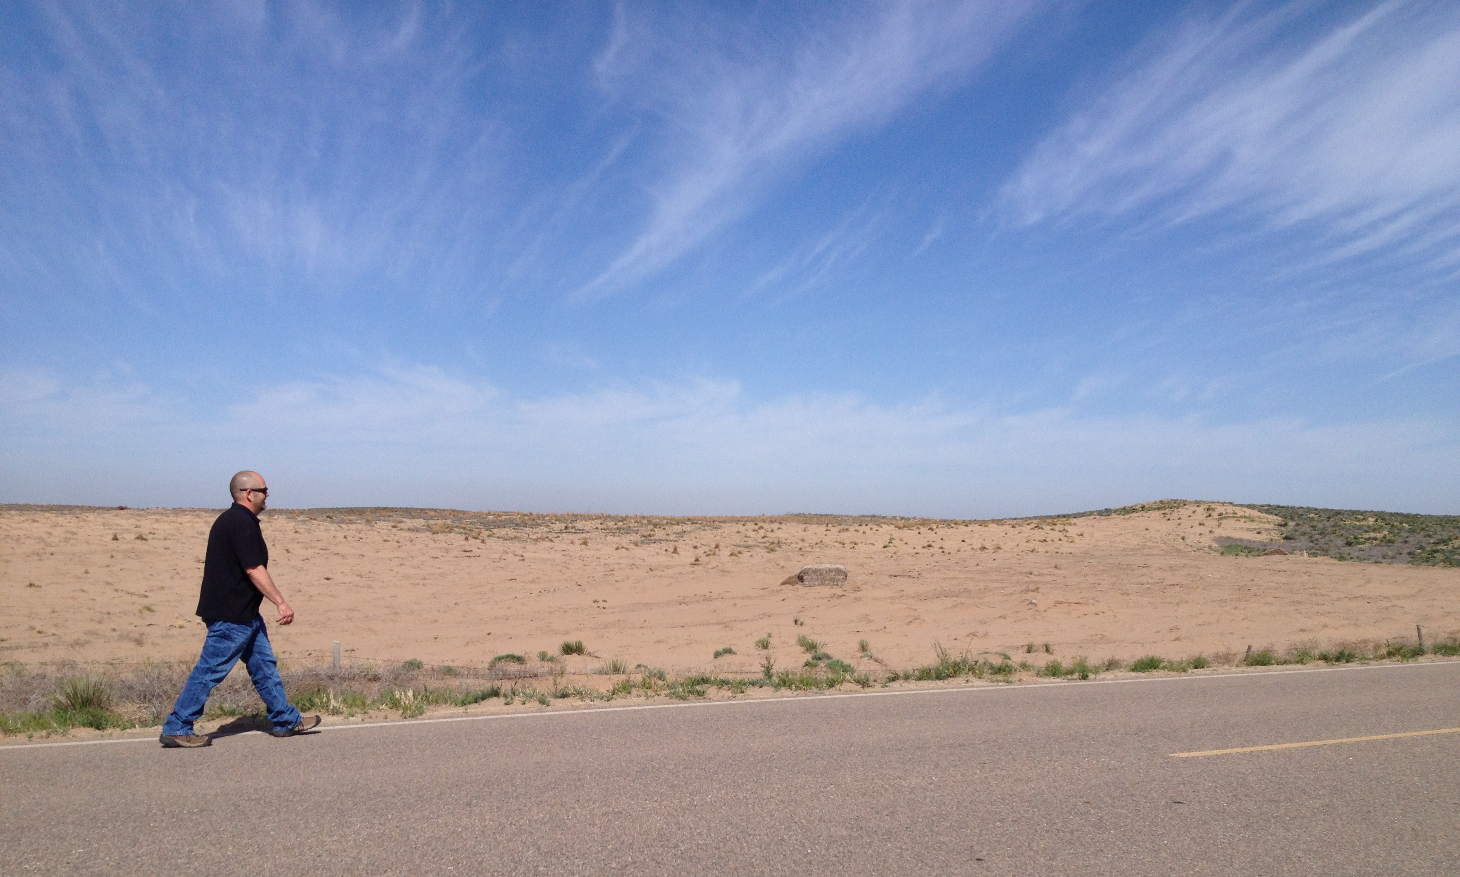
Other Land Uses
Associated Ag Land
Water
Other land: mined land rocky, barren etc.
Best principles of impact for these areas are maximizing cover and minimizing disturbance
Photo: SHD NRCS
Photo: IA NRCS
Notes:
Associated Agriculture Lands - Land associated with farms and ranches that are not purposefully managed for food, forage, or fiber and are typically associated with nearby production or conservation lands. This could include incidental areas, such as idle center pivot corners, odd areas, ditches and watercourses, riparian areas, field edges, seasonal and permanent wetlands, and other similar areas.
Water - Geographic area whose dominant characteristic is open water or permanent ice or snow. May include intermingled land, including tidal-influenced coastal marsh lands.
Other - Land that is barren, sandy, rocky, or that is impacted by the extraction of natural resources, such as minerals, gravel or sand, coal, shale, rock, oil, or natural gas
Photo on left is other land barren rocky land that doesn’t grow anything, right is water and assoc. ag land as the area around the perimeter is riparian area

Slide 20
Current Books Promoting Soil Health
What media resources have you seen or heard?
  Building Soils for Better Crops for example...
Notes:
Use a chart and paper and document on the paper a list of books they are aware of and post it on the wall so they can see them or copy them down later.
Be sure to use some of yours if the listing is slow going.
SARE has good resources, the Lowenfels books “teaming with..”, Gabe Brown book, all the David Montgomery books, web pages, etc.

Slide 21
Farmers are Catching the Vision of Improving Soil Function through Management ***
Potential place of champions https://www.nacdnet.org/get-involved/soil-health-champions-network/
Add photos form your state.
Notes:
Present this slide only if you update it. Add photos of different landuse operations.
***THIS SLIDE SHOULD BE CHANGED FOR EACH LOCATION. ASK LOCAL STAFF FOR PHOTOS OF SOIL HEALTH FARMERS. THESE WERE COPIED FROM THE NACD SOIL HEALTH CHAMPIONS PAGE AND OBTAINED FROM NRCS PUBLIC AFFAIRS.
There are farmers in your region of the country, and some in your state, who are beginning to understand that improving soil health is critical to the sustainability of their operations.
You could ask if anyone knows any of these producers.
DURING THE FOLLOWING SESSIONS WE WILL DIVE INTO HOW WE CAN MANAGE TO IMPROVE THE FUNCTION OF OUR DEGRADED SOILS

Slide 22
Worksheet and Scenarios
Go over class worksheet
Pass out scenarios and group up individuals
First question do you need to make any assumptions about your scenario? Is there anything missing?

